Slide 1
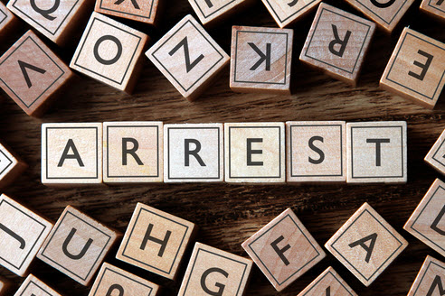
Why Am I Here?

Slide 2
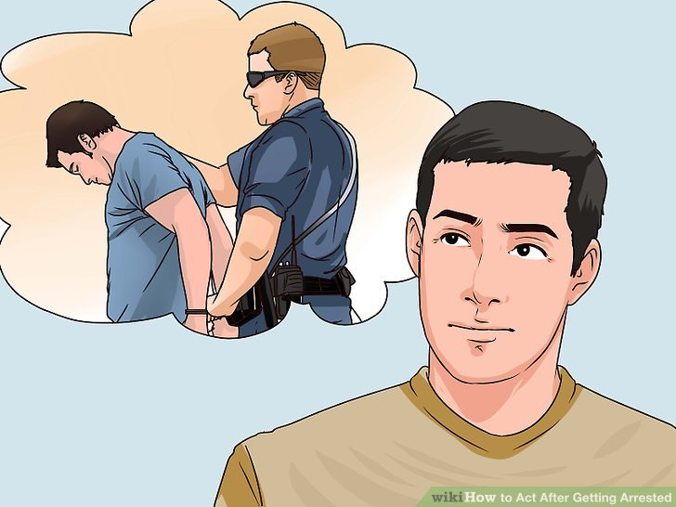
What were you Arrested for?
How do you feel about the arrest?

Slide 3
Did you know that the common response to any arrest is that it is demeaning, embarrassing, uncomfortable, and a down right shi@&y experience.
What was it like for you?

Slide 4
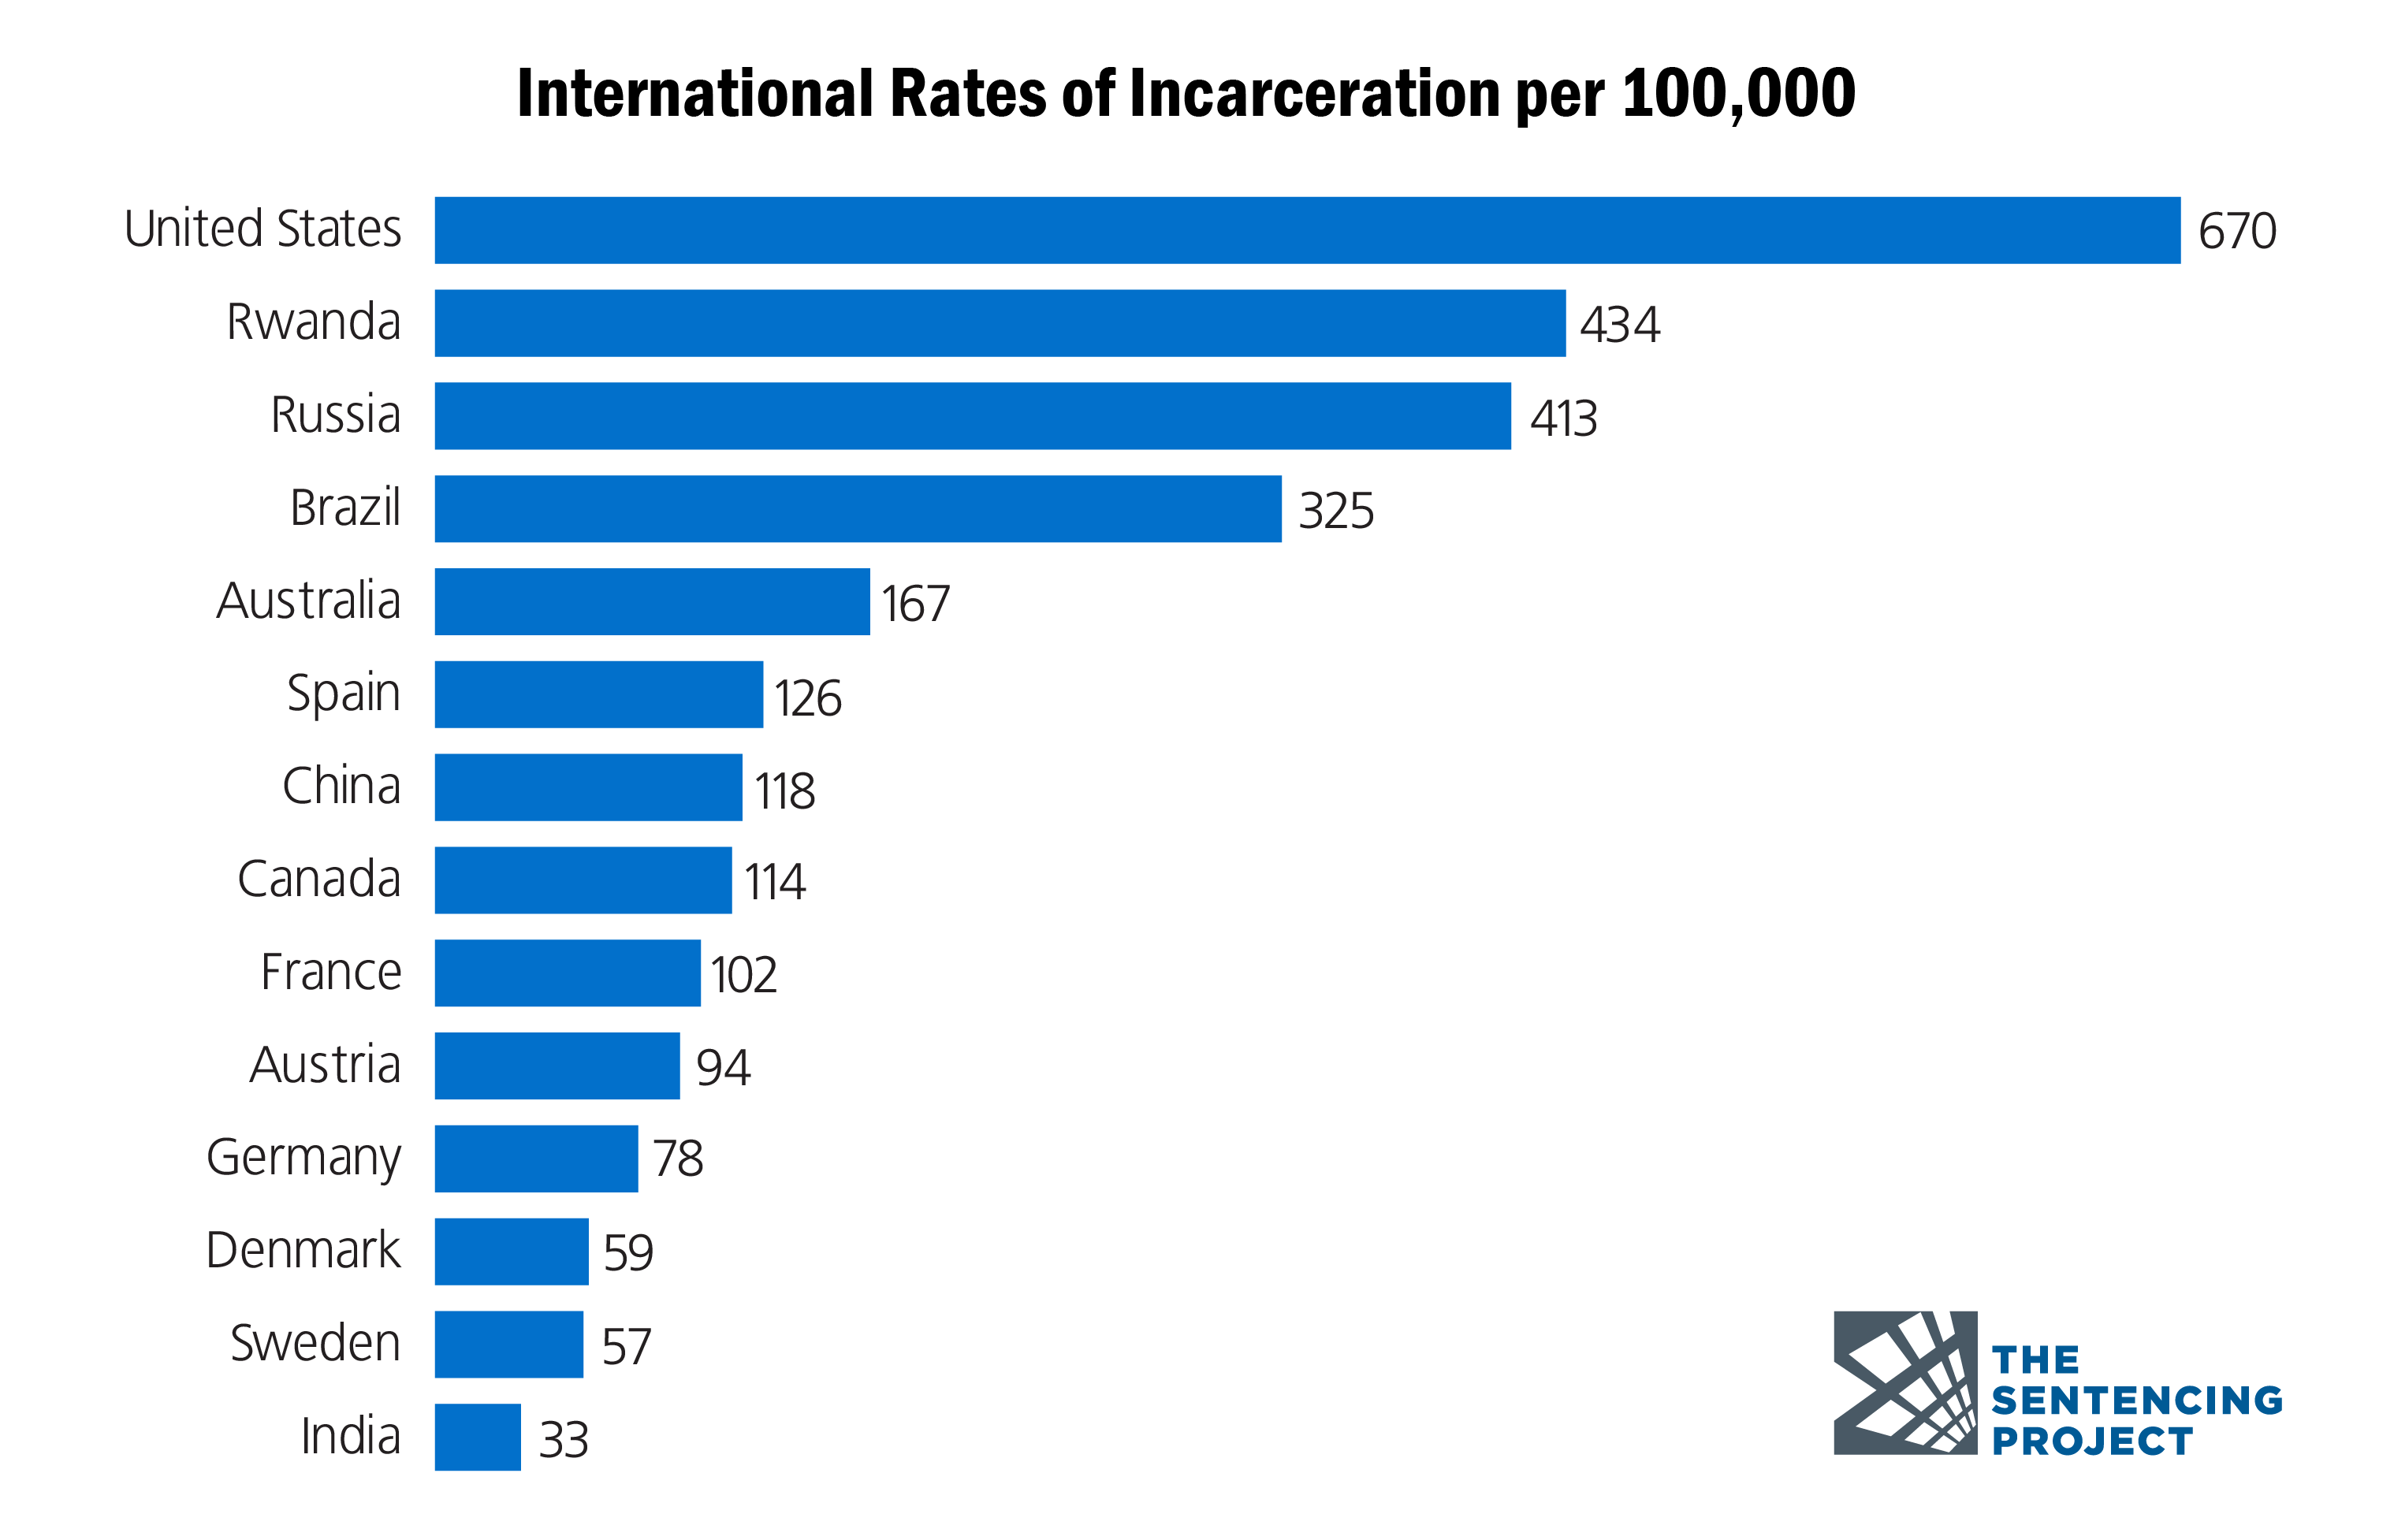
Did you know we arrest more people here than anywhere else in the world?

Slide 6
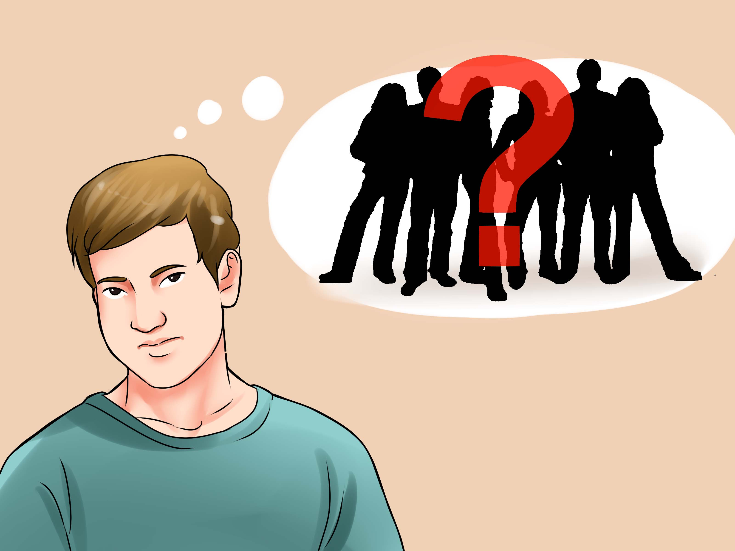
A lot of individuals blame someone else for their arrest…
The problem with blame, is it gets you nowhere fast….

Slide 7
When you blame others you give all your power away. However, if you take responsibility, then there are options….

Slide 8
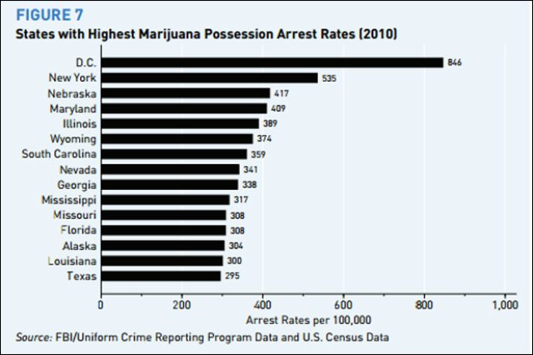

Slide 10
At a state and national level, drug offenses are a dominant cause leading to arrests and incarceration.

Slide 11
Getting arrested and spending time in jail will impact your life. How much is up to you.
Think about details of you arrest, what were you doing before it occurred?
Who were you with? Has this person been in trouble before?

Slide 12
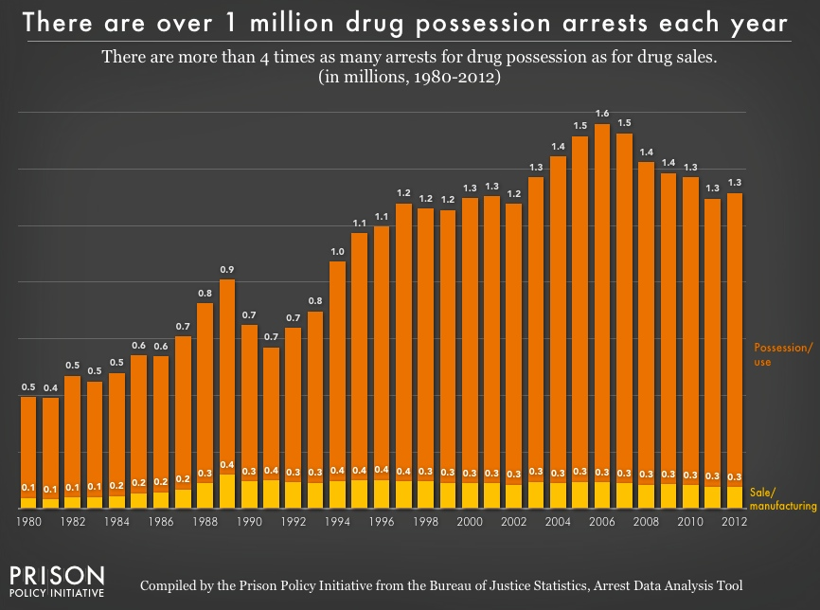

Slide 13
Then there is going to court, the cost of an attorney, the delayed hearings. And finally, here you are…

Slide 14
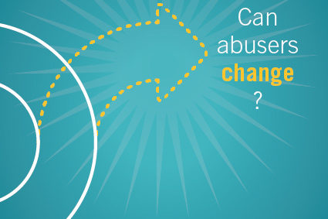
Consequences & Poor Life Choices

Slide 15
Look at the consequences of your life choices, drug & alcohol use, as well as your arrest and incarceration.

Slide 16
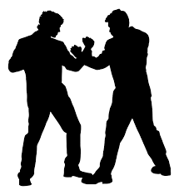
Legal Consequences
DUI; Reckless Operation; Domestic Violence Charges; Public Intoxication; Open Container Assault; Theft; Drug Trafficking; Drug Abuse; Loss of Children; No Driver's License; Unpaid Fines/ Tickets…

Slide 17
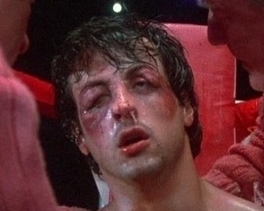
Physical Consequences
Ulcers and/or Cirrhosis; Accidents * Bar Fights * Cut/ Stabbed * Shot Migraine * Hangovers * Blackouts
Weight Gain/Loss; Heart Burn; Beat up * Whiplash * Teeth Knocked Out Broken Nose * Broken Bones * High Blood Pressure * Heart Problems…

Slide 18
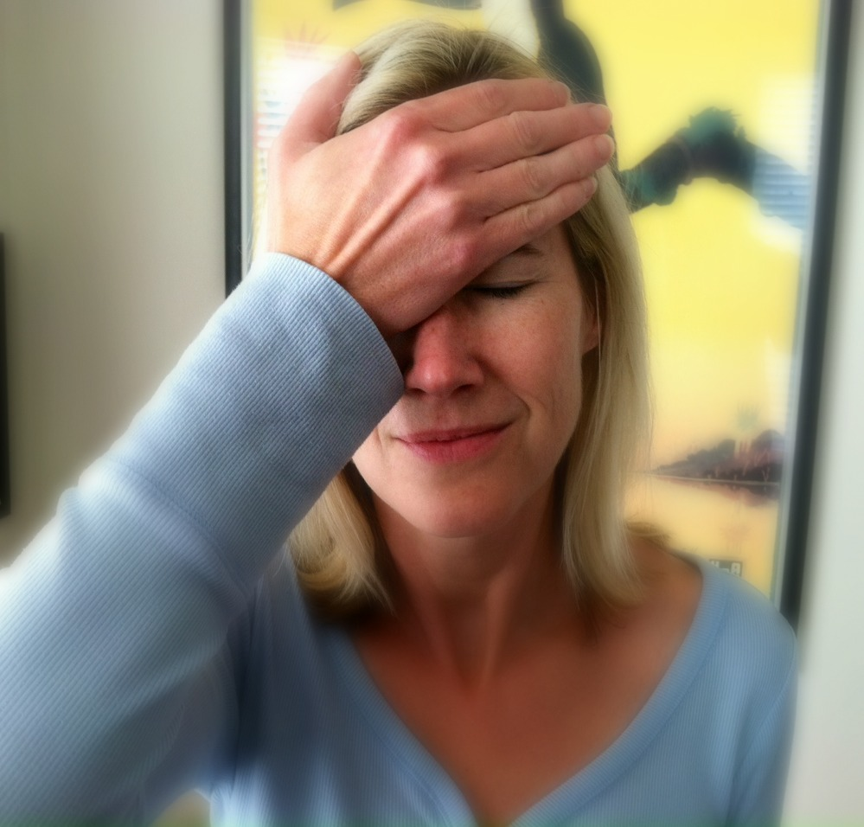
Social Consequences
Friends worry about you; Family and friends are embarrassed about your arrest; Your social circle is impacted; A lot of time revolves around the use of alcohol or drugs...

Slide 19
Employment Consequences
Missing Work; Losing Jobs; Lost Job Opportunities; Lost Time At Work; Had To Take Comp. Time

Slide 20
Family Consequences
Family complaints… Time spent away using when it could be spent with the family? Money spent on drugs or alcohol that could’ve been spent on family?

Slide 21
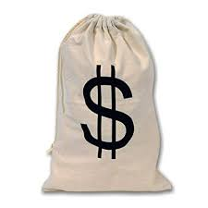
Adding It All Up How much has this arrest cost?

Slide 22
How much did Court Cost?
Fines?
Lost wages?
Interlock?
SCRAM?
Probation Fees?

Slide 23
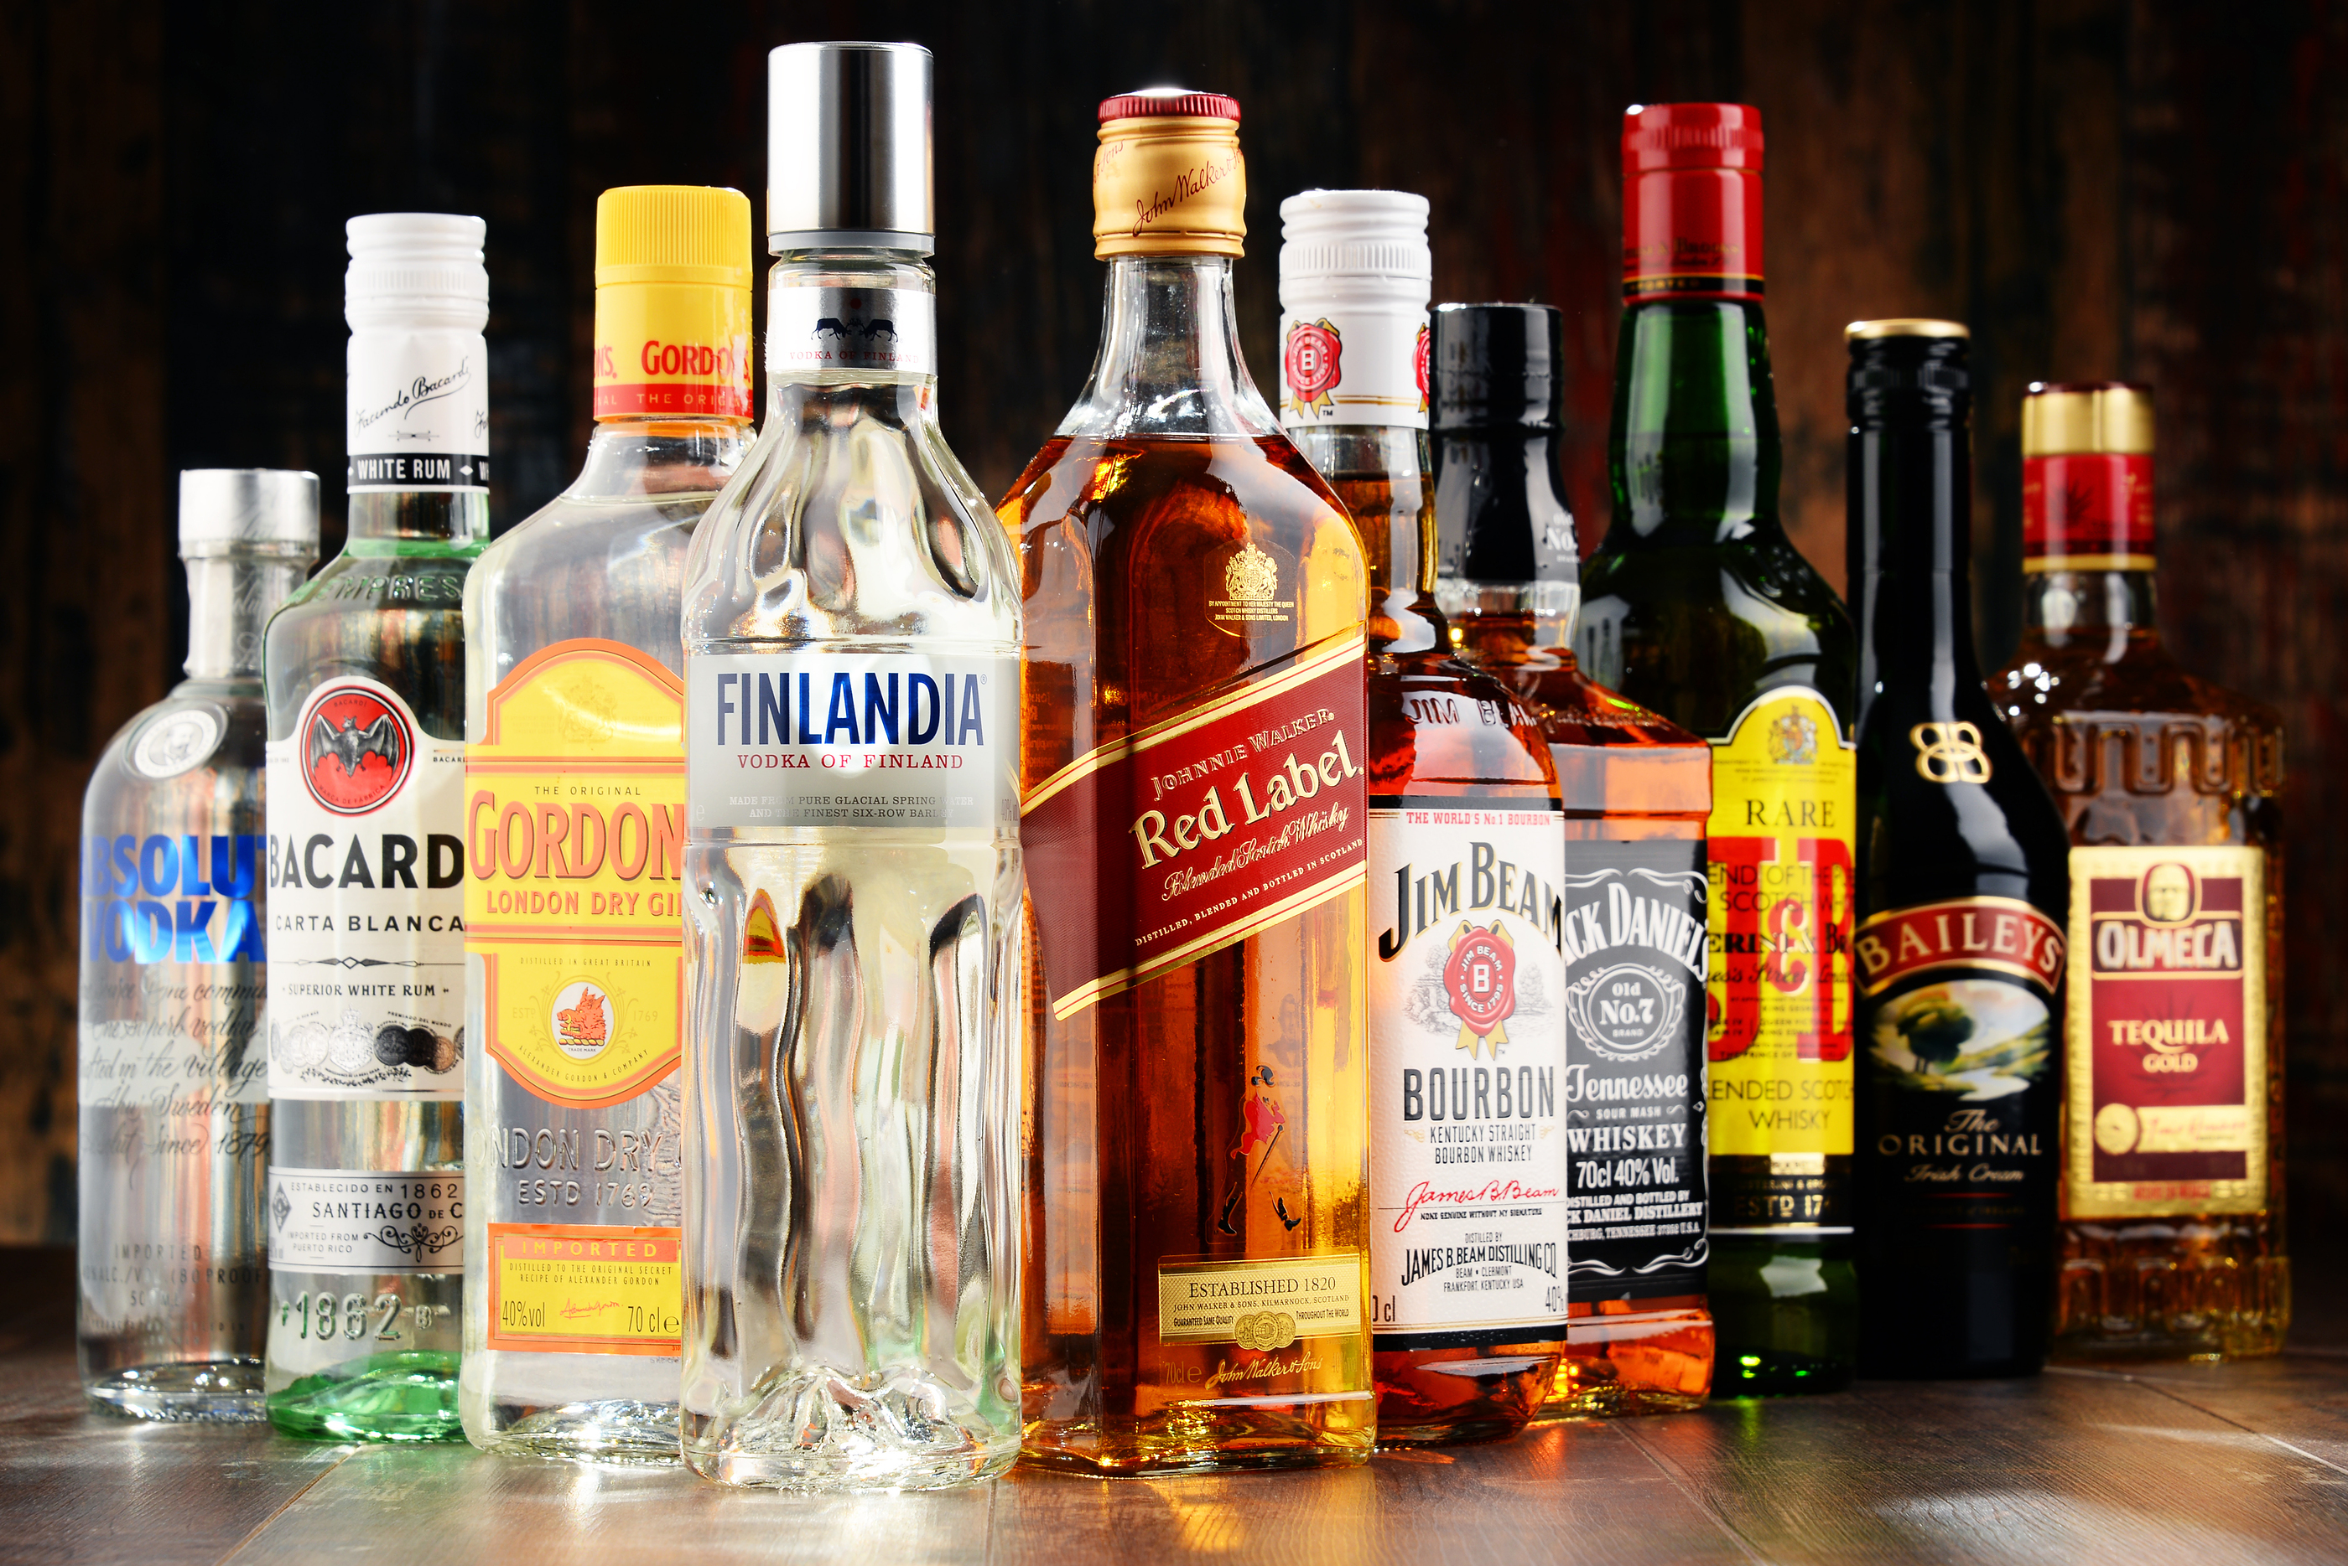
How much do you spend on Alcohol?
Daily?
Weekly?
Monthly? Annually?

Slide 24
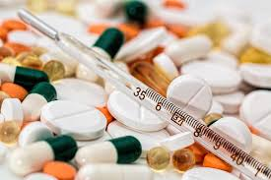
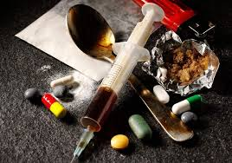
How much do you spend on drugs?
Daily?
Weekly?
Monthly?
Annually?

Slide 25
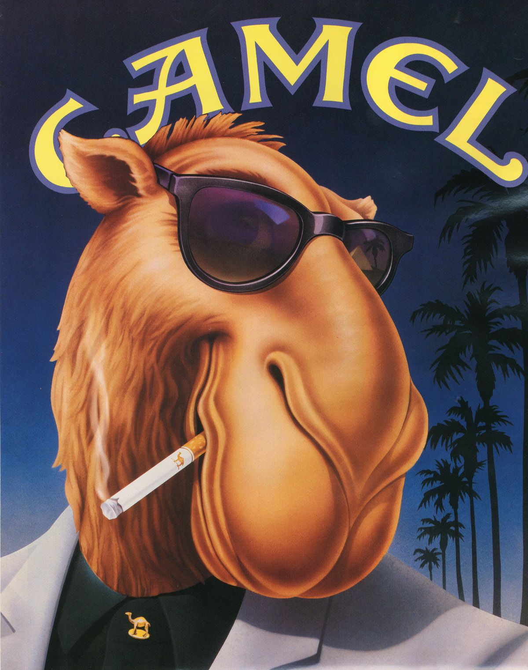
How much do you spend on cigarettes?
Daily?
Weekly?
Monthly?
Annually?

Slide 26
So, after adding it all up….
Looking at the emotional fall out of being arrested…
The complications to your life that incarceration initiates…
And the straight up loss of money…

Slide 27
It is worth thinking about, diving into,
considering,
really evaluating why you make the choices that you make and …
Understanding what influences these choices.

Slide 28
