Slide 1
Addiction’s Resource Center
Driver Intervention Program
ARC-ip @2019 Form F1 Read out Loud

Slide 2
Welcome to ARC-ip
Staff Introductions
Schedule
Emergency Procedures
Payment
Rules, and Expectations
Client Rights, Grievance, and Agreements
Confidentiality and Considerations
Release of Information
Psychometric Testing: AUDIT; MAST; DAST
Medications, Ordering food, and Escort to Sleeping Rooms
ARC-ip @2019 Form F1 Read out Loud

Slide 3
Staff Introductions
Professional Disclosures: Addiction's Resource Ctr, INC
Executive Director, Services Supervisor
W. L. Thomas PsyD, MRC, LICDC-CS (933744), ICADC (128695)
Adult Remedial Authorizing Official (1335), Adult Remedial Instructor (5453)
Services Supervisor: Maria Fazio-McCarty MS, LPC (1100206), LICDC (071031) , LSW (S.0013594)
Site Directors:
Stash H. BS, CDCA 171022, Remedial Instructor RD 9753, Intake, Security & Safety Officer
Justin K. Assoc., CDCA II (164456) Counselor, Instructor, Intake, Screening & Assessment,
Andrea MA, CDCA 170080, Remedial Instructor RD 10097, Instructor, Intake, Security
Counselors & Instructors:
Shawn Layne Remedial Instructor RD- 2720,), Disabled Drivers Instructor
Angel BS, CDCA On-Call Site Director, Instructor, Counselor, Intake & Screening, Security
Danielle CDCA Instructor, Counselor, Intake & Screening, Security
Janna CDCA II Counselor, Small Groups, Intake & Screening
Mandy CDCA II Counselor, Small Groups, Intake & Screening
Lorrie T. CDCA On-Call Site Director, Instructor, Counselor, Intake & Screening, Security
Monshare H. BS, LCDC II 161399 On Call Counselor & Instructor
Night Security Staff
Danielle CDCA, Jordan, Lea, Dominic
Office Staff: Jesse and Taurie / Adam and Lea
Volunteers: AA Speakers & State Highway Patrol

Slide 4
Schedu
L
e
Thursday – Open & Files
3:00-5:30PM Check in, Entrance Interviews, Room Checks, Room Assignments
5:45-7:00PM PPT – Program Open -Rules, Rights, Confidentiality, Releases, Schedule Review Files, Clients Order Food
7:00-8:00PM Room Assignments; Medication; Reviews Security Protocol; Food Delivery, Lockdown

Slide 5
Schedu
L
e
Certified Remedial Driving Course (DO NOT ALTER)
6:45AM Wake-up calls
7:15AM Escort to breakfast
8:00AM Attendance; License Look up; DUI Dead in 5 Seconds Break 9:20
9:30AM FLI Workbooks, Pre-Appraisal, Pages 3-6, PreTrip
Safety Pgs 7-8, Critical Elements Segment pgs 9-17, Special Conditions 18-23, AoD Lecture - Face the Facts/
Reaction Time (RD HO 1) (Breaks every 70-90 minutes)
12:30PM Lunch 45 Minutes
1:15PM Situational Driving Pages 24-End/
OVI Law - Sentencing Standards (RD HO 2)
2:45PM Break
3-4PM Take Remedial Test; Grade Test; Remedial Sign up
5:00PM Break
5:15PM Dr. Phil- How You Look Drunk – Continue with Sign Up
6:00PM Dinner
6:45 Marijuana Nation - (Film & Discussion)(Client order food)
7:45PM Escort to Sleeping Rooms

Slide 6
Schedu
L
e
6:45AM Wake-up then at 7:15AM Escort to breakfast
8-8:50AM Intervention -Allyson (Poly Substance Abuse)
9-9:50AM PPT 1 Understanding Additions – Signs and Symptoms
10-10:50AM Intervention -Gabe & Vanessa (Gambling, Shopping,
Eating and Personality Disorders)
11-11:50PM PPT 1 - Cycles & Triggers, Dual Diagnosis
11:50PM Lunch
12:30PM Grp 1 –Small Group Form 1-4 Intro-PPP-OVI-DIP (1.5hr)
2:00PM Break
2:10PM Grp 2 & 3 Expenses – Adding it up/ Jury Trial (1hr)
3:10PM Break
3:20PM Group 4 – Consequence Worksheet -Identifying Risk-1.5hr
4:50PM Break
5-6:00PM Action Plan – Client identifies clear plan to not reoffend –
document on Case Note Grp Hrs 1hr)
6-6:30PM Dinner
6:30-8PM World’s Most Dangerous Drug: Meth

Slide 7
Schedu
L
e
Sunday
7:30 Wake up calls
8:30-9AM Room Clean out
9:00AM American Addict
10:30AM Break
11:00AM MADD Part 1– Lives Affected (film-27 min.)
discussion
12:00 Lunch Break
1:00PM AA Speaker
2:00PM Surveys and Jeopardy
3-4:00PM Dismissal, all car keys and medications
returned.

Slide 8
Emergency Procedures
Emergency/ Disaster–Call 911(Review at Program Open & Hang up ) OAC 5122-29-12
Emergency Medical Plan - Client Illness, Heart Attack, Seizure, Injury etc
Stabilize client per first aid instruction - Call 911 as soon as possible. Clients who are in physical distress will be transported by Fire Dept or EMS.
Location of First Aid Kit: Main staff table at all times during the program. OAC 5122-29-12(I)1b
Supervision of Clients: All clients, except for the injured person(s) shall be escorted to a secure area and monitored by secondary staff or be moved back to their sleeping room and lockdown procedure followed. OAC 5122-26-12
ARC-ip @2019 Form F1 Read out Loud

Slide 9
Emergency Procedures
Client illness,
Please let a staff person know so we can assist you. OAC 5122-29-12(I)1d
Fire, Bomb Threats, Gas Leaks, Utility Malfunction (threats to safety on site at hotel) – Leave the building by the stairs, report to the front of the hotel or where Firemen direct you
Tornado
Get to an area where there are no windows (bathroom)
Earthquake
Stand in doorways, get under tables, protect yourself from falling debris
Nuclear Power Plant (N/A)
Handling Hazardous Materials & Disposal of Waste Materials
If a staff/ client is near hazardous materials or needs to dispose of waste materials, they need to seek out hotel personnel.
If a client becomes ill or is transported to the hospital, the site director or night security person will contact the client’s emergency contact. OAC 5122-29-12
Alien Invasion – We all go home.
ARC-ip @2019 Form F1 Read out Loud

Slide 10
Emergency Procedures
ARC-ip Fire Disaster Plan
1. Remain calm, but react quickly. Activate the nearest alarm. Call 911, report there is a fire at that particular site if possible.
2. At the sound of the alarm all staff and clients will evacuate their perspective hotel using the emergency evacuation route posed in the rooms and on doors. Clients and staff will congregate in the front parking lot of their perspective hotel. The staff person in charge will do a head count to ensure that all staff and client were able to evacuate the Hotel.
ARC-ip @2019 Form F1 Read out Loud

Slide 11
Emergency Procedures
ARC-ip Tornado/ Severe Weather Disaster Plan
As soon as a potential for severe weather is indicate, the staff person in charge will monitor the local radio station for current weather information;
Remain calm but react quickly
Tornado Warning: The staff person in charge will locate all clients and staff and notify them of a tornado warning. Clients and staff will move to the first floor of the Hotel into a hallway running north to south. The staff person in charge will so a head count to ensure that all staff and clients are accounted for. Clients and staff will stand with their backs to a west wall and remain there until an all clear is given. Clients and staff may return to their rooms/ conference room once an all clear is given.
As soon as possible the staff person in charge will notify the Exec. Director concerning the tornado/ severe weather situation.
The staff person will complete an incident report concerning what has occurred, and a copy of the incident report will be included in each client’s file.
Other Disasters – Follow same plan as delineated above.
ARC-ip @2019 Form F1 Read out Loud

Slide 12
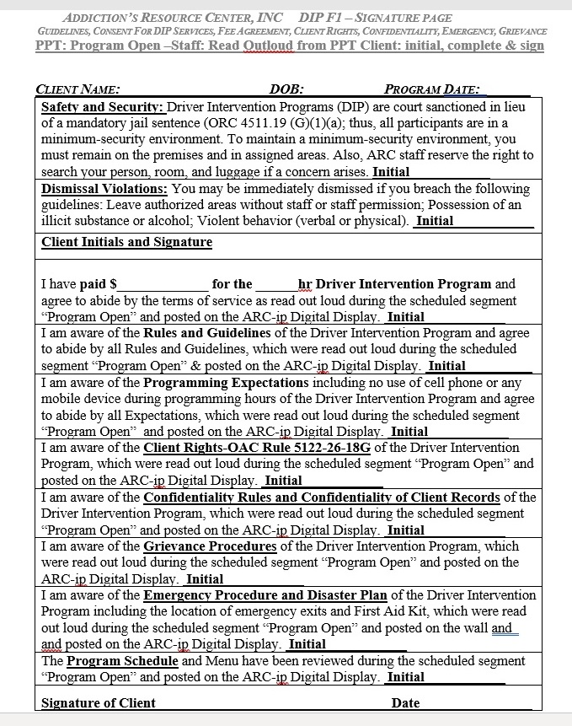
Sign Off Form
As we go through the slides we will be reading off each section. Please initial and sign as we go through the Expectations, Rules, and Safety Procedures.

Slide 13
Program Payment
I have paid $ for the hr Driver Intervention Program and agree to abide by the terms of service as defined below. Name of Agency Rendering Services: Addiction’s Resource Center, INC. Type of service: Driver Intervention Program (DIP): educational segments (lectures, small groups, and films), intake, screening, interviews including referral (where deemed necessary) to individuals who have substance abuse problems or legal charges related to the use of substances (legal and illegal). The fee includes food (catering pre-arranged for group consumption), sleeping room (type is dependent on amount of fee -shared, double, or private), and completion report faxed to referral court, one attorney, and treatment facility if referral is made. Any and/or all other services may initiate additional fees.

Slide 14
Rules – Court-Ordered Program
DIP Rules/ Guidelines
Safety and Security: As a minimum-security environment it is necessary that we establish guidelines and rules. Violation of these guidelines (rules) may lead to being dismissed from the program.
This is a court sanctioned DIP in lieu of mandatory jail sentence. You’re considered to be in a minimum-security environment. You must remain on the premises in assigned areas and attend all sessions.
Throughout the program we reserve the right to search your person, room, and luggage.
You are present on a voluntary basis and can elect to leave. If you leave the program prior to complete, there is no program refund.
ARC-ip @2019 Form F1 Read out Loud; Clients sign and initial

Slide 15
Rules
You are not allowed to possess any beverage alcohol, prescription or non-prescription drugs without the express permission of the program administrator or her designated person. If you are on prescription medication or non-prescription medication this medication must be examined and held by ARC staff to be taken at the appropriate time under the supervision of the program staff.
No knives, guns or other weapons permitted.
No "violent" behavior. "Violent" behavior is defined as: fighting; threatening, obscene, loud or abusive language; racial / ethnic slurs, jokes or innuendos.
ARC-ip @2019 Form F1 Read out Loud; Clients sign and initial

Slide 16
Rules – Sleeping Rooms
You will be escorted back to your room at the end of class. Between 8 & 9pm there will be a room check. Room checks may be done throughout the night as necessary.
You may not leave your room or open your door without staff present unless it is an emergency.
The room you are staying in is not your personal hotel room; it is a program sleeping room provided by ARC-DIP. Any vandalism or destruction of the room will be charged to you.
You cannot smoke in any room. If you do you will incur a $250 fee for cleaning.
All sleeping rooms are ARC program rooms, you are issued one set of bath towels for the weekend. Also, the room may not have housekeeping service so please keep it tidy.
You are not allowed to make calls from your room except to the conference room for assistance by night security staff. If you make outside calls you are responsible for the phone fees.
You’re not allowed in other clients’ rooms or to go back to your rooms during breaks or meals.
You’re not allowed to talk with hotel guests and no visitors are permitted during the weekend.
All rooms are subject to search at any time by staff - You should dress in sleeping attire.
Lights and electronics off by 11:00pm. Disruptive behavior in sleeping rooms leads to dismissal.

Slide 17
Program Expectations
All Cell Phones, iPads, Smart Pads, Laptops, iWatch, Android watch, any electronic device must be turned in and are not allowed during class. No pictures should be taken.
Smoking is permitted only during breaks and only in the
designated area. Do not throw butts on the ground.
You should be dressed in appropriately no ball caps,
sunglasses, hoodies, and nothing revealing.
I’ve been read, understand, & agree to abide by fee agreement (I) & rules/ guidelines (II) at ARC-DIP
Please sign Form DIP F1- Signature Page
ARC-ip @2019 Form F1 Read out Loud; Clients sign and initial

Slide 18
Client Rights OAC Rule 5122-26-18 G
The right to be treated with consideration and respect for personal dignity, autonomy and privacy;
The right to reasonable protection from physical, sexual or emotional abuse and inhumane treatment;
The right to give informed consent to or to refuse any service:
The right to be free from restraint or seclusion unless there is immediate risk of physical harm to self or others;
The right to be informed and the right to refuse any unusual or hazardous procedures;
The right to be advised and the right to refuse observation by others and by techniques such as one-way vision mirrors, tape recorders, video recorders, television, movies, photographs or other audio and visual technology. This right does not prohibit an agency from using closed-circuit monitoring to observe seclusion rooms or common areas, which does not include bathrooms or sleeping areas;
The right to confidentiality of communications and personal identifying information within the limitations and requirements for disclosure of client information under state and federal laws and regulations;
The right to have access to one's own client record;
The right to be informed of the reason for terminating participation in a service;
The right to be informed of the reason for denial of a service;

Slide 19
Client Rights OAC Rule 5122-26-18 G
The right not to be discriminated against for receiving services on the basis of race, ethnicity, age, color, religion, gender, national origin, sexual orientation, physical or mental handicap, developmental disability, genetic information, human immunodeficiency virus status, or in any manner prohibited by local, state or federal laws;
The right to know the cost of services;
The right to be verbally informed of all client rights, and to receive a written copy upon request;
The right to exercise one's own rights without reprisal, except that no right extends so far as to supersede health and safety considerations;
The right to file a grievance;
The right to have oral and written instructions concerning the procedure for filing a grievance, and to assistance in filing a grievance if requested;
The right to be informed of one's own condition; and,
The right to consult with an independent treatment specialist or legal counsel at one's own expense.

Slide 20
Grievance Provcedure
Rule 5122-26-18
The Grievance must be in writing.
The grievance must be signed and dated by client/ individual filing the grievance on behalf of themselves or person filing grievance.
The grievance must include the following:
  Date of occurrence; Approximate time the situation occurred; Description of incident;
  and names of individuals involved.
The grievance must include a statement identifying to whom the client should/is giving the grievance.
ARC-IP Site Program Director or an appointed staff member at the Program
The ARC-ip will make a resolution decision on the grievance within 21 days calendar days of receipt of the grievance. Any extenuating circumstances indicating that this time period will need to be extended must be documented in the grievance file and written notification given to the client.
Assistance will be provided in filing the grievance if needed by staff on duty at time the griever requests if griever files while at the program. An investigation of the grievance on behalf of the griever and agency representation for the griever at the agency hearing on the grievance if desired by the griever.
Addictions Resource Center, INC Exec Director/Services Supervisor: W. L. Houser-Thomas PsyD, LICDC-CS PO Box 807 Yellow Springs OH 45387 Ph: (937) 767-0178/ Fax: 937-688-1550
OhioMHAS 30 E Broad St, Columbus, OH 43215 Ph: (614) 466-2596 Fax: (614) 485-9737
Ohio Legal Rights 50 West Broad Street, Suite 1400 Columbus, Ohio 43215-5923 Phone: 614-466-7264 or 1-800-282-9181 (toll-free in Ohio only) TTY: 614-728-2553 or 1-800-858-3542
US DEPT. OF HHS
Region V - Chicago (Illinois, Indiana, Michigan, Minnesota, Ohio, Wisconsin Office for Civil Rights-U.S. Department of Health and Human Services 233 N. Michigan Ave., Suite 240 Chicago, IL 60601 Voice Phone (312)886-2359 FAX (312)886-1807 TDD (312)353-5693

Slide 21
Confidentiality
Confidentiality Is Essential
Confidentiality of clients (in general):
Any program that specializes, in whole or in part, in providing treatment, counseling, and/or assessment and referral services for clients with substance abuse disorders must comply with the Federal confidentiality regulations (§2.12(e))
Confidentiality of Client Records (42CFR Part 2):
“This information has been disclosed to you from records protected by federal confidentiality rules (42 CFR Part 2). The federal rules prohibit you from making any further disclosure of this information unless further disclosure is expressly permitted by the written consent of the person to whom it pertains or as otherwise permitted by 42 CFR Part 2. A general authorization for the release of medical or other information is not sufficient for this purpose. The Federal rules restrict any use of information to criminally investigate or prosecute any alcohol or drug abuse client.

Slide 22
Confidentiality
While at the program do not do the following:
Post group photos of you and the people in the program on Facebook
Do not tell anyone outside of the program who is in the program with you
If people in the hotel ask what you are doing in the program, tell them it is a work training, Ancient Alien Astronaut Convention, etc… anything but that you are here for an OVI
Confidentiality Is Essential

Slide 23
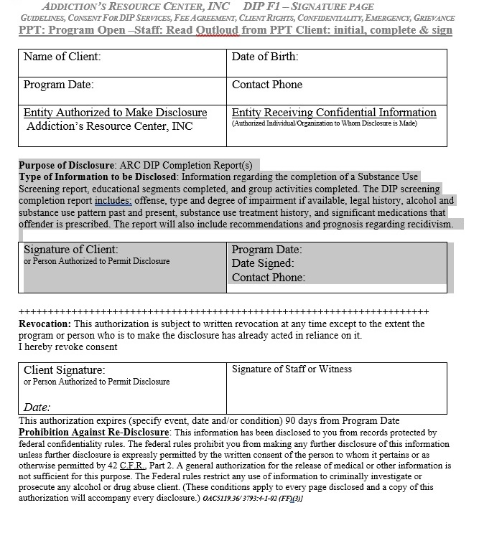
Release of Information
Name of Client: | Date of Birth:
Program Date: | Contact Phone
Entity Authorized to Make Disclosure Addiction’s Resource Center, INC | Entity Receiving Confidential Information (Authorized Individual/Organization to Whom Disclosure is Made)
Purpose of Disclosure: ARC DIP Completion Report(s)
Type of Information to be Disclosed: Information regarding the completion of a Substance Use Screening report, educational segments completed, and group activities completed. The DIP screening completion report includes: offense, type and degree of impairment if available, legal history, alcohol and substance use pattern past and present, substance use treatment history, and significant medications that offender is prescribed. The report will also include recommendations and prognosis regarding recidivism.
Signature of Client: or Person Authorized to Permit Disclosure | Program Date: Date Signed: Contact Phone:

Slide 24
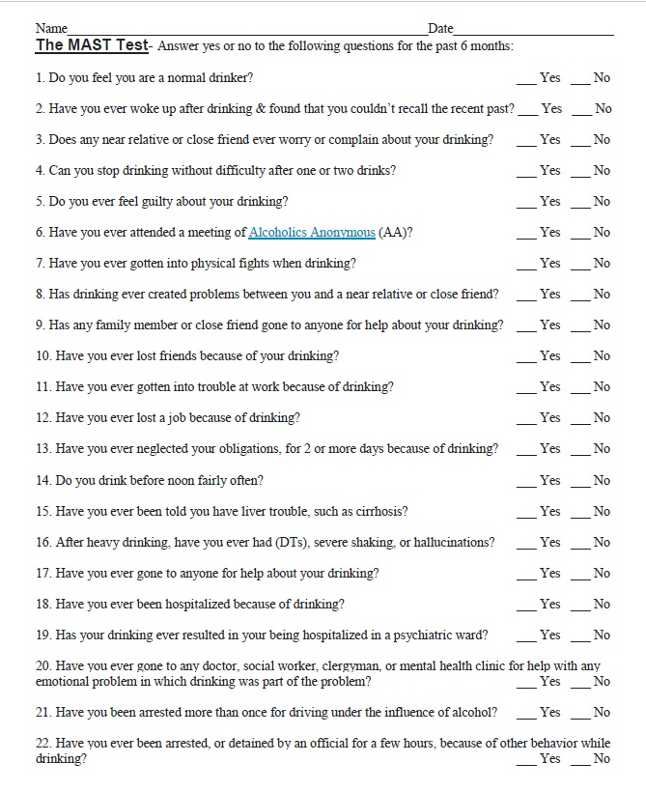
Psychometric Testing: MAST
ARC-ip @2019 Form F1 Read out Loud

Slide 25
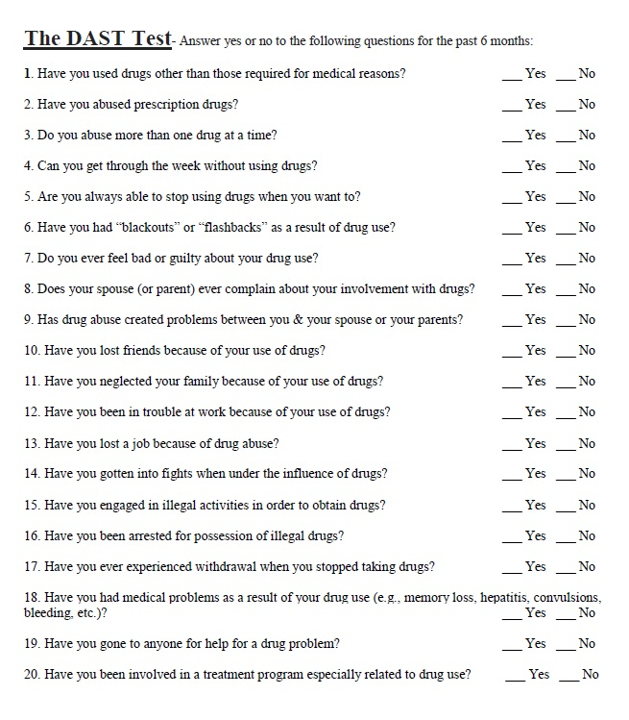
Psychometric Testing: DAST
ARC-ip @2019 Form F1 Read out Loud

Slide 26
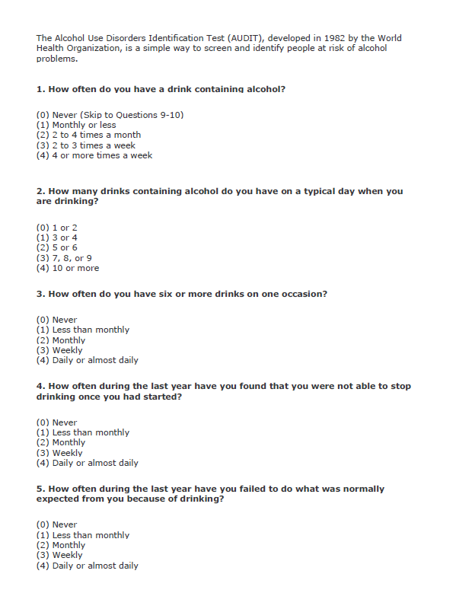
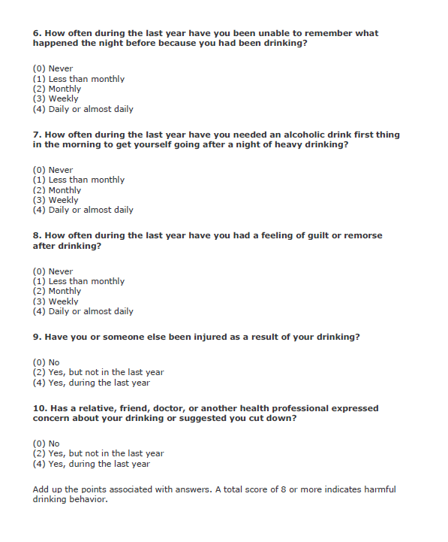
Psychometric Testing: AUDIT
ARC-ip @2019 Form F1 Read out Loud

Slide 27
Ordering food at night
Please order your food at the start of the last moive (usually started around 6:30-7:00 pm.
Have your food delivered to the conference room prior to going to your sleeping room.
ARC-ip @2019 Form F1 Read out Loud

Slide 28
Medications, Smokers, Escort to Sleeping Rooms
Please approach front table for medication before going to sleeping room (if you have medication).
Lockdown & Sleeping Room Escort Procedures:
You will be given room key in order for you to get ice and drinks prior to being locked in your room
Night security will be right behind you to check your presence in your room, take the room key and lock you in for the night.
Smokers will be retrieved from their rooms at the time night security has set with you.
ARC-ip @2019 Form F1 Read out Loud

