Slide 1
Nothing happens in a vacuum what others do effect us and what we do effects others
WL Houser-Thomas PsyD, LICDC-CS Addiction’s Resource Center, INC @2016

Slide 2
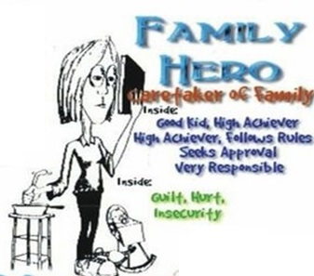
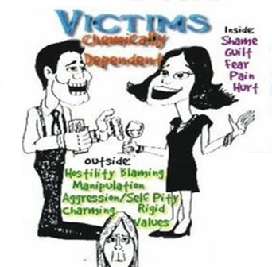
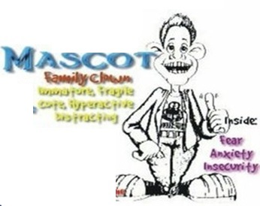
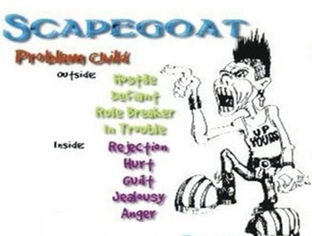
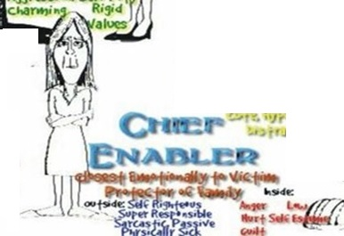
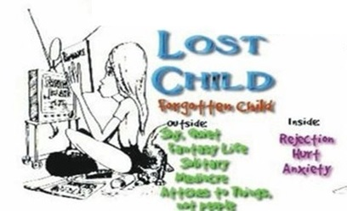
Family Dynamics the snowball effect of substance abuse

Slide 3
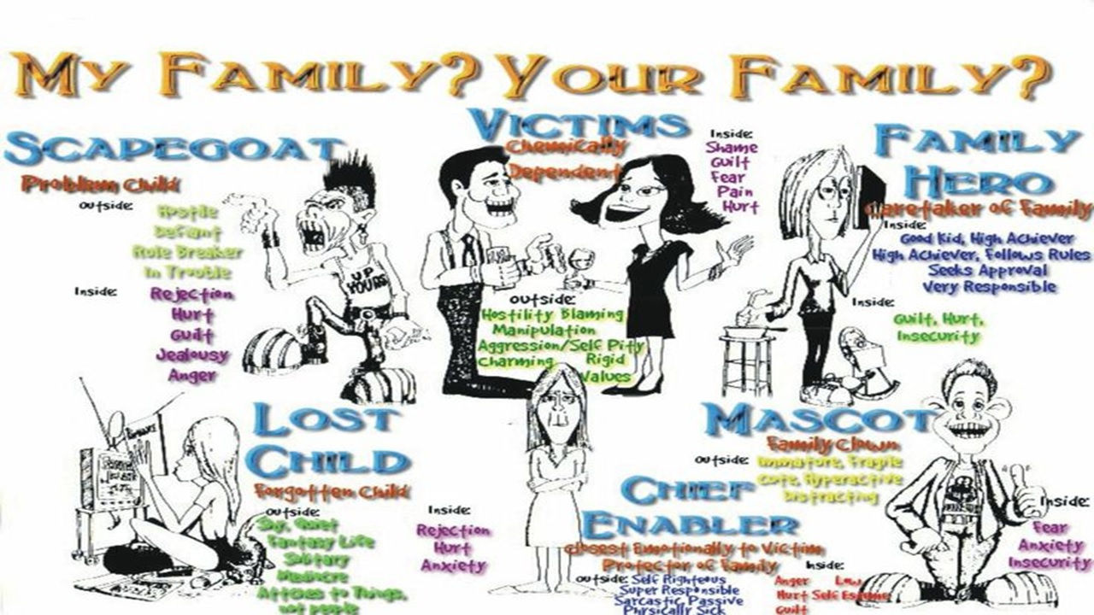

Slide 4
Addiction, Alcoholism, Substance Abuse, Mental Illness Effect Those Around Them Be It Family, Friend, or Foe

Slide 6
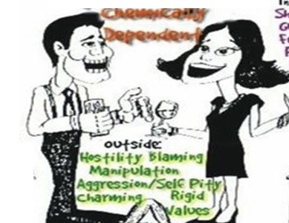
First there is the Addict or Alcoholic

Slide 7
Then there is the Enabler

Slide 8
The Enabler:
Super Responsible, Seriousness, Self-Blaming, Self- Pity, Provides Responsibility Inner Feelings: Hurt, Anger, Loneliness, Provides Responsibility

Slide 9
The Enabler:
Characteristics: Takes Over Responsibility For The Family, Especially Chemically Dependent Person.
Without Help: Continuing Power Struggle, Low Self-Esteem, Feelings of Powerlessness.
With Help: Responsible, High Esteem, Caring Capable.

Slide 10
Mama’s best helper… The Hero

Slide 11
Family Hero
Visible Success, Does What's Right Works Hard, For Approval- Provides Self-Worth (Family Can Be Proud) Inner Feelings: Inadequate, Confusion, Pain Characteristics: High Achiever, Grades, Sports, Understands problems w/ family, Feels Responsible for Family

Slide 12
Family Hero
Without Help: Workaholic, Never Wrong, Responsible For Everything, Often Marry Chemical Dependent; With Help: Responsible, Feels Good Inside About Success, Confident.
Tends to be the Oldest Child of the Family

Slide 13
The Lost Child

Slide 14
Lost Child
Withdrawn, Quietness, Rejection, Distant, Loner – Provides Relief, One Child Not To Worry About Inner Feelings: Loneliness, Hurt, and Inadequacy, Fear Characteristics: School Day Dreamer, Company Drone, Social Loner, "Invisible" Quiet, No Friends.

Slide 15
Lost Child
Without Help:
High risk to continue cycle, depression, suicidal, isolative, difficult to befriend, withdraw, uncomfortable and afraid, socially awkward and uncomfortable with others.
If the focus moves to them, they panic.
They are unable to express emotion, because they have learned it doesn’t pay.

Slide 16
Lost Child
With Help:
Super independent
Can handle everything for themselves
Adventurous
Tends to be the Middle Child

Slide 17
The Mascot

Slide 18
Mascot
Anything To Attract Attention, Clowning Behavior, Immature, Fragile Provides Comic Relief, Fun & Humor
Inner Feelings: Insecurity, Fear, Confusion
Characteristics: School Or Company Clown, Social Cut-Up, Short Attention Span.

Slide 19
Mascot
Without Help: Hyperactive, Compulsive Clown, Insecure, Marry Hero For Care.
With Help: Takes Care Of Self, Good Sense Of Humor, Fun, Confident, Secure.
*Tends to be the baby of the family*

Slide 21
Scapegoat
Anything To Attract Attention, Clowning Behavior, Immature, Fragile Provides Comic Relief, Fun & Humor
Inner Feelings: Insecurity, Fear, Confusion Characteristics: School Or Company Clown, Social Cut-Up, Short Attention Span.

Slide 22
Scapegoat
Characteristics: Family Clown, Social Cut-Up, Short Attention Span. Without Help: Hyperactive, Compulsive Clown, Insecure, Marry Hero For Care. With Help: Takes Care Of Self, Good Sense Of Humor, Fun, Confident, Secure.

Slide 24
Family Rules Don’t Talk Don’t Trust Don’t Feel

Slide 25
Don't Talk: Fueled by fear and control This rule starts out by rationalizing and making excuses for the addiction.

Slide 26
Don't Talk: rationalization over time makes the addiction normal. In some families there is not even excuse making, but rather there is nothing said about the addiction.

Slide 27
Don’t Trust Trust is based on confidence, faith, and reliance. Children need security and focused attention to feel like they have support for whatever they are going through.

Slide 28
Don’t Trust These components are often missing in a home where there is a chemical addiction. Children become confused from their parents’ mixed messages due to the addiction.

Slide 29
Don't Feel: The "don't talk" and "don't trust" rules contribute directly to a child’s inability to share or express their feelings.

Slide 30
Don't Feel
Children living with an addicted parent are often in such desperation that they find the only way to cope is by repressing (ignoring, restraining, or hiding) their feelings or just not feeling anything at all.

Slide 31
But Keep in Mind….
Everyone does the best they can and
Everything works out in the end

Slide 32
Groups that help: Alanon & Alateen
ACOA Meetings Adult Children of Alcoholics
(there are endless groups to help, just use the google.)

