Slide 1
Alcohol, Drugs, Driving & You
Information Presentation on Mood Altering Substances

Slide 2
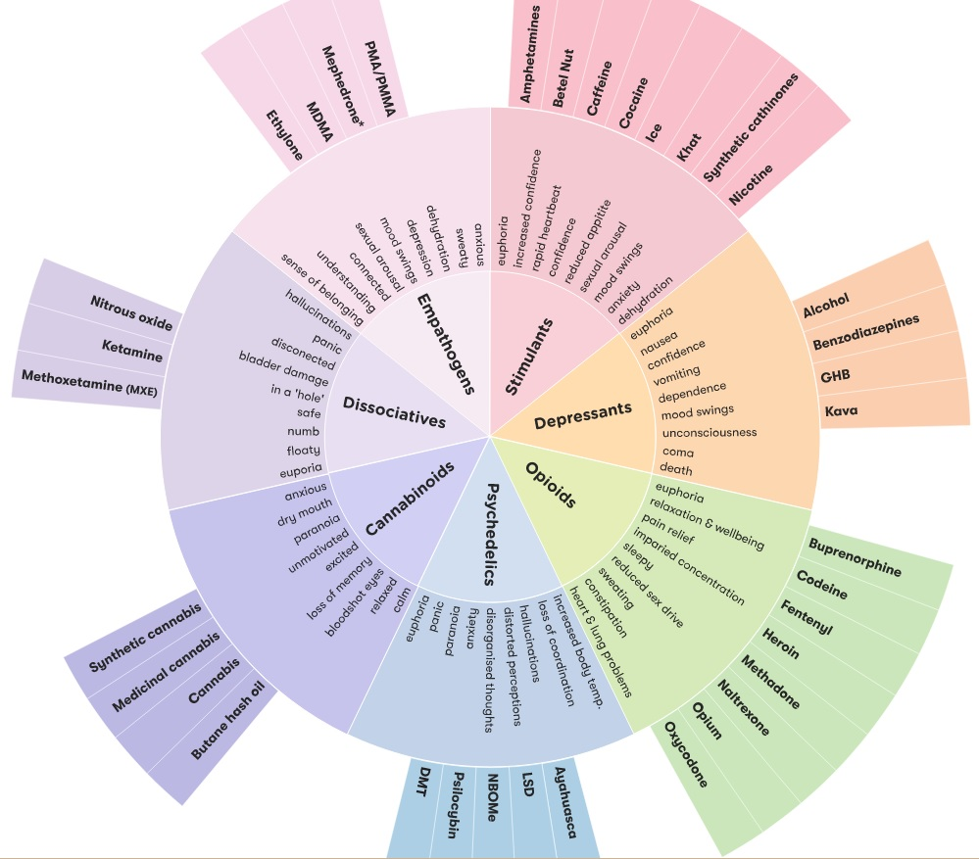
The Drug Wheel
Classification of Drugs
Notes:
First, we should identify that drugs can be classified in many ways. They can be grouped according to:
uses (medicinal or recreational)
effect on the body (the specific effect on the central nervous system)
source of the substance (synthetic or plant)
legal status (legal/illegal/decriminalised)
risk status (dangerous/safe).¹
The Drug Wheel is a classification model that groups different types of drugs based on the effect they have on the body. It has seven categories. Stimulants
Empathogens
Psychedelics
Dissociatives
Cannabinoids
Depressants
Opioids
We will look at each classification and how that family of drugs effect driving skills.

Slide 3
Drugged Driving
Why is drugged driving dangerous?
Notes:
More key facts: The effects of specific drugs on driving skills differ depending on how they act in the brain. For example, marijuana can slow reaction time, impair judgment of time and distance, and decrease coordination. Drivers who have used cocaine or methamphetamine can be aggressive and reckless when driving. Certain kinds of prescription medicines, including benzodiazepines and opioids, can cause drowsiness, dizziness, and impair cognitive functioning (thinking and judgment). All of these effects can lead to vehicle crashes.

Slide 4
Drugged Driving
Drugged driving is driving a vehicle while impaired due to the intoxicating effects of recent drug use. It can make driving a car unsafe—just like driving after drinking alcohol. Drugged driving puts the driver, passengers, and others who share the road at serious risk.
Notes:
Research studies have shown negative effects of marijuana on drivers, including an increase in lane weaving, poor reaction time, and altered attention to the road.
Use of alcohol with marijuana makes drivers more impaired, causing even more lane weaving.
Some studies report that opioids can cause drowsiness and impair thinking and judgment.
Other studies have found that being under the influence opioids while driving can double your risk of having a crash.
It is difficult to determine how specific drugs affect driving because people tend to mix various substances, including alcohol. But we do know that even small amounts of some drugs can have a measurable effect.

Slide 5
Drugged Driving
Zero Tolerance – What does it mean?
Notes:
Zero-tolerance laws have been adapted to include drugged driving. This means a person can face charges for driving under the influence (DUI) if there is any amount of drug in the blood or urine. Many states are waiting to develop laws until research can better define blood levels that indicate impairment, such as those they use with alcohol.

Slide 6
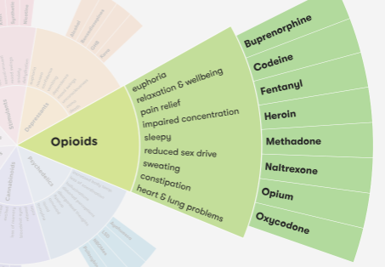
Opioids
Opioids are substances that act on opioid receptors to produce morphine-like effects. Medically they are primarily used for pain relief, including anesthesia.
Notes:
Opioids bind to and activate opioid receptors on cells located in many areas of the brain, spinal cord, and other organs in the body, especially those involved in feelings of pain and pleasure. When opioids attach to these receptors, they block pain signals sent from the brain to the body and release large amounts of dopamine throughout the body. This release can strongly reinforce the act of taking the drug, making the user want to repeat the experience.

Slide 7
Opioids
Common prescription opioids:
hydrocodone (Vicodin®)
oxycodone (OxyContin®, Percocet®)
oxymorphone (Opana®)
morphine (Kadian®, Avinza®)
codeine
fentanyl
Notes:
Opioid misuse can cause slowed breathing, which can cause hypoxia, a condition that results when too little oxygen reaches the brain. Hypoxia can have short- and long-term psychological and neurological effects, including coma, permanent brain damage, or death. Researchers are also investigating the long-term effects of opioid addiction on the brain, including whether damage can be reversed.

Slide 8
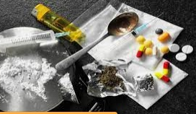
Experience
extreme relaxation
drowsiness and clumsiness
confusion, slurred speech,
slow breathing and heartbeat.
Opioids
Notes:
Opioids include certain types of pain killers, known as ‘opioid pain medications’ and illegal drugs, such as heroin. Some opioids are plant-based and come from the opium poppy (opiates), whilst others are synthetic or ‘man-made’.
Common types of opioid include codeine (Panadeine®, Panadeine Forte® and Nurofen Plus®), fentanyl, morphine, oxycodone (Endone® or OxyContin®), buprenorphine (Subutex® or Suboxone®), methadone (Methadone Syrup® and Biodone Forte®), tramadol and heroin.
Newer psychoactive opioid substances include: U-47700, AH-7921, O-desmethyltramadol, MT-45, acetylfentanyl and furanyl-fentanyl.

Slide 9
Opioids
In large doses
cold, clammy skin
slow breathing
blue lips and fingertips
falling asleep (‘going on the nod’)
death by respiratory depression

Slide 10
Opioids
Long-term effects:
increased tolerance
constipation
dependence
damage to vital organs such as the lungs, brain and heart
Notes:
Using opioids with other drugs
The effects of taking opioids with other drugs – including over-the-counter or prescribed medications – can be unpredictable and dangerous, and could cause: Opioids + alcohol, cannabis or benzodiazepines: slow down breathing and brain activity, and increased risk of overdose. Opioids + ice, speed or ecstasy: enormous strain on the heart and kidneys, and increased risk of overdose

Slide 11
Effects of Opioids on Driving
drowsiness
confusion
nausea
constipation
euphoria
slowed breathing
Notes:
Along with marijuana, prescription drugs are linked to drugged driving crashes. In 2016, 19.7 percent of drivers who drove while under the influence tested positive for some type of opioid.

Slide 12
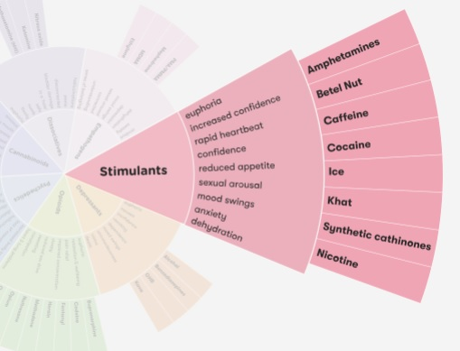
Stimulants are a class of drugs that speed up messages travelling between the brain and body. They make a person feel more awake, alert, confident or energetic.
Stimulants
Notes:
Stimulants include caffeine, nicotine, amphetamines and cocaine. Large doses can cause over-stimulation, resulting in anxiety, panic, seizures, headaches, stomach cramps, aggression and paranoia. Long-term use of strong stimulants can have adverse effects.

Slide 13
Illicit stimulants are usually snorted, swallowed, smoked or injected.
Prescribed stimulants are usually taken orally, and the duration of their effects differs depending on the type.
Stimulants
Notes:
There is no safe level of drug use. Use of any drug always carries some risk. It’s important to be careful when taking any type of drug.

Slide 14
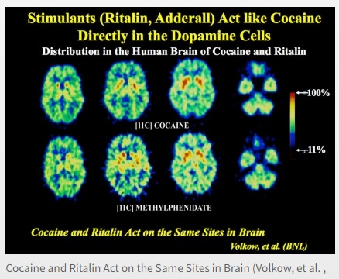
Notes:
Effects are:
euphoria
heightened feelings of wellbeing
increased heart rate and blood pressure
increased alertness
talkativeness

Slide 15
Higher doses may result in:
anxiety
tension
increased body temperature
nausea
tremor
seizures
coma
death
Stimulants
Notes:
The effects of taking stimulants with other drugs − including over-the-counter or prescribed medications − can be unpredictable and dangerous

Slide 16
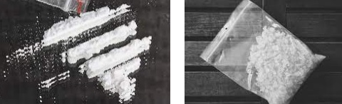
Effects of Stimulants on Driving
sleepiness/drowsiness
blurred vision
dizziness
impairs cognitive functions such as working memory and movement perception
Notes:
Cocaine and methamphetamine can make drivers more aggressive and reckless. Using two or more drugs at the same time, including alcohol, can amplify the impairing effects of each drug a person has consumed. Some prescription and over-the-counter medicines can cause extreme drowsiness, dizziness, and other side effects.

Slide 17
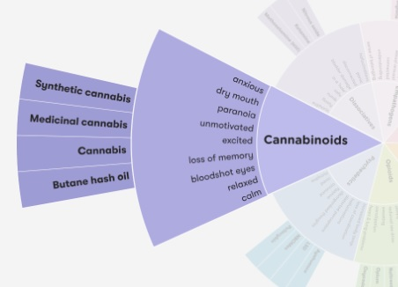
Cannabinoids
Similar to opioids, cannabinoids produce their effects by interacting with specific receptors, located within different parts of the central nervous system. Simply put, cannabinoids regulate how cells communicate - how they send, receive, or process messages
Notes:
Types of cannabinoids
Cannabis – the dried leaves and flowers (buds) of the cannabis plant that are smoked in a joint or a bong. This is the most common form.
Hemp – the fibre of the cannabis plant, extracted from the stem and used to make rope, strong fabrics, fibreboard, and paper.
Medicinal cannabinoids including pharmaceutical cannabis products that are approved by an organisation such as the Therapeutic Goods Administration (TGA), including nabiximols (Sativex®) and synthetic cannabinoids such as Dronabinol®.⁵
HU-210 – a synthetic analogue of THC, first synthesized in Israel in 1988 and considered to have a potency of at least 100 times that of THC.⁵
UR-144 – similar effects to THC, though slightly less potent than THC.⁶
JWH – a series of synthetic cannabinoids created in 1994 by Dr John W. Huffman for studies of the cannabinoid receptors.⁷
5F-ADB – a synthetic cannabinoid that was first identified in late 2014 from post-mortem samples taken from an individual who had died after using a product containing this substance.⁸
CUMYL-PEGACLONE emerged in late 2016 on the German drug market.⁹ Anecdotal reports suggest that there are a number of adverse effects associated with CUML-PEGACLONE.

Slide 18
Cannabinoids
How are they used?
Illicit and synthetic cannabinoids are usually smoked, vaporized or eaten. Pharmaceutical or medicinal cannabinoids come in a variety of products including raw (botanical) cannabis which may be vaporized for medicinal purposes, as well as oils, liquids and oral sprays. Gels have also been developed for direct application to the skin.
Notes:
What are synthetic cannabinoids?
Over the years a number of synthetic cannabinoid products have been produced. They are similar to those of natural cannabis, yet, these drugs can be more potent and have been associated with a number of adverse effects.
Synthetic cannabinoids are molecules designed to mimic the effects of THC. Like THC, these synthetic cannabinoids target the cannabinoid type 1 receptor (CB1R) in the brain, which is responsible for the psychoactive effects of THC in cannabis.¹¹

Slide 19
Effects of Marijuana/ Cannabinoids
The effects of cannabis may be felt immediately if smoked or vaporized, or within an hour or two if eaten.
euphoria
feelings of well being
spontaneous laughter & excitement
increased appetite
dry mouth
quiet and reflective mood
Notes:
Cannabinoids and other drugs
The effects of mixing cannabis with other drugs, including alcohol, prescription medications and over-the-counter medicines, are often unpredictable.
Using alcohol and cannabis at the same time can increase the unpleasant effects, including nausea, vomiting and feelings of panic, anxiety and paranoia.

Slide 20
Effects of Marijuana on Driving
impair your judgment
motor coordination
ability to concentrate
slow your reaction time
Notes:
Effects of cannabinoids also include:
altered senses (for example, seeing brighter colors)
altered sense of time.
changes in mood.
impaired body movement.
difficulty with thinking and problem-solving.
impaired memory.
hallucinations (when taken in high doses)
delusions (when taken in high doses)

Slide 21
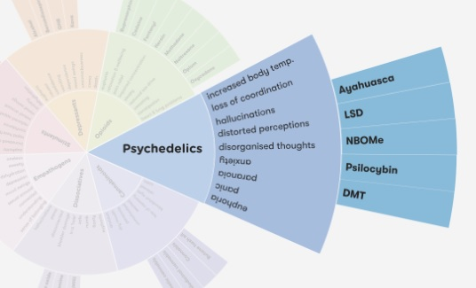
Psychedelics
Psychedelics (also known as hallucinogens) are a class of psychoactive substances that produce changes in perception, mood and cognitive processes
Notes:
Psychedelics affect all the senses, altering a person’s thinking, sense of time and emotions. They can also cause a person to hallucinate—seeing or hearing things that do not exist or are distorted.
There are many different kinds of psychedelics. Some occur naturally, in trees, vines, seeds, fungi and leaves. Others are made in laboratories.

Slide 22
Types of Psychedelics
There are many types of Psychedelics, a few examples:
LSD
Peyote Tea
Mushrooms
Notes:
Types of psychedelics
LSD (Lysergic acid diethylamide) is made from a substance found in ergot, which is a fungus that infects rye.
Psilocybin is a naturally occurring substance found in mushrooms and is found in many parts of the world.
Mescaline is derived from the Mexican peyote and San Pedro cactus and produces similar effects to LSD.
DMT (Diemethyltryptamine) is structurally similar to psilocin, an alkaloid found in psilocybin mushrooms. It can be synthesised in the laboratory but is also a naturally occurring component of several plants.
DOM is a member of the DOx family of compounds which are known for their high potency, long duration, and mixture of psychedelic and stimulant effects.²
2C-B (4-Bromo-2,5-dimethoxyphenethylamine) is a psychedelic drug first synthesised in 1974. 2C-B is considered both a psychedelic and a mild entactogenic. ‘Entactogen’ means ‘touching within’ and is a term used by psychiatrists to classify MDMA and related drugs.³
Peyote Peyote (Lophophora williamsii) is the most well-known and potent psychedelic cactus, although the smallest and slowest growing. Instead of growing upward to form a column, it grows as ‘buttons’ low to the ground. It has been used by Native Americans for over 5000 years.⁴
25[-x]-NBOMe NBOMe (N-methoxybenzyl) is the name for a series of drugs that have psychedelics effects. Reports indicate that there are a number of different versions of NBOMe available – all with differing effects.⁵

Slide 23
Effects of psychedelics can last several hours and vary considerably, depending on the specific type of psychedelic:
feelings of euphoria
sense of relaxation & wellbeing
seeing and hearing things that aren’t there
confusion and trouble concentrating
Dizziness
blurred vision
Clumsiness
breathing quickly
Vomiting
sweating and chills
Notes:
Psychedelics affect all the senses, altering a person’s thinking, sense of time and emotions. They can also cause a person to hallucinate—seeing or hearing things that do not exist or are distorted.
There are many different kinds of psychedelics. Some occur naturally, in trees, vines, seeds, fungi and leaves. Others are made in laboratories.

Slide 24
Driving on Psychedelics
The effects of hallucinogens can severely disrupt a driver's ability to pay attention to the road. Do not drive if you have used any type of drug in this family of drugs.
Notes:
It is completely crazy to drive while taking Psychedelics.

Slide 25
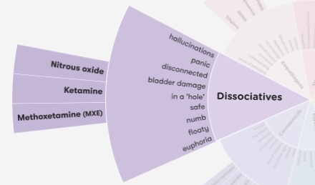
Dissociatives
Dissociatives are a class of psychedelic drug. This class of drug is characterized by distorted sensory perceptions and feelings
Notes:
Examples of dissociatives
Ketamine – dissociative anaesthetic that is used in surgery and veterinary medicine. It causes amnesia (memory loss) and analgesia (pain-relief). Low doses produce stimulant effects; medium to high doses produce possible out-of-body or near death experiences.²
PCP – Phencyclidine (PCP) is a drug that has both hallucinogenic and dissociative properties. The dissociative effects of PCP leaves users feeling removed from their body and their environment. This effect produces a trance-like state. It also has strong anaesthetic effects, which produces amnesia (memory loss) and analgesia (pain-relief). Also known as “angel dust”.³
DXM – (lean, dank) Dextromethorphan is a medication usually used as a cough suppressant in cold and cough medicines. It is sold in syrup, tablet, spray, and lozenge forms.⁴
Nitrous Oxide – (nangs) Nitrous oxide is a dissociative anaesthetic and has been found to produce dissociation of the mind from the body (a sense of floating), distorted perceptions and in rare cases, visual hallucination.⁵

Slide 26
Driving on Dissociatives
Driving or operating machinery, as a person’s ability to judge distance and space is extremely limited.
Notes:
There is no safe level of drug use. Use of any drug always carries some risk – even medications can produce unwanted side effectsUse of dissociatives is likely to be more dangerous when:
taken in combination with alcohol or other drugs, in particular benzodiazepines and opiates as these can slow breathing and increase the risk of overdose
used in unsafe environments such as nightclubs or festivals. There have been several reports of people hurting themselves whilst impaired and attempting to move around
used in large doses or repeatedly dissociatives may be neurotoxic, meaning toxic to the nervous system
alone (in case medical assistance is required)
the person has a mental health problem.⁹
Nausea can happen on many dissociatives, usually directly after dosing – usually only if there are stomach contents. It is best to not eat for 3-4 hours before dosing.

Slide 27
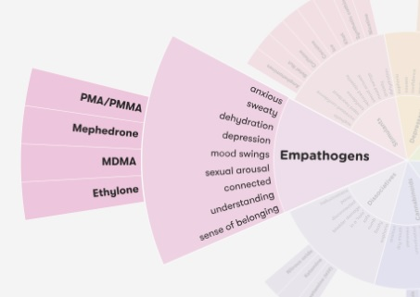
Empathogens
Empathogens increase an individual’s feeling of empathy and benevolence towards others and increase feelings of being socially accepted by and connected to others.¹ They can increase friendliness and playfulness, but can also cause mood swings, dehydration and depression
Notes:
Empathogens cause the release of dopamine and serotonin in the brain. Serotonin controls mood, appetite and sleep, and can make you feel relaxed. Using empathogens can cause the serotonin levels in the brain to become very low, and can also lead to hyperthermia. Empathogens such as MDMA are usually found in pill, crystal or capsule forms. They are most commonly swallowed, but can be snorted or shelved (used rectally).

Slide 28
Empathogens
Common Effects
feeling a sense of belonging, understanding or connection
sexual arousal
serotonin syndrome
energy
overheating
risk of dehydration/overhydration
erectile dysfunction
overdose
Notes:
Empathogens and other drugs
Using empathogens with other drugs can be dangerous, in particular with other drugs that increase the amount of serotonin in the brain, including antidepressants, SSRIs, L-Tryptophan and other empathogens.⁴ High levels of serotonin can lead to serotonin toxicity or serotonin syndrome. This is a serious condition with symptoms such as confusion, agitation, sweating, increased heart rate and muscle spasms, and can be fatal.

Slide 29
Empathogens & Driving
Effects of drugs on driving?
reduced concentration
drowsiness
difficulty processing information
difficulty doing more than one thing

Slide 30
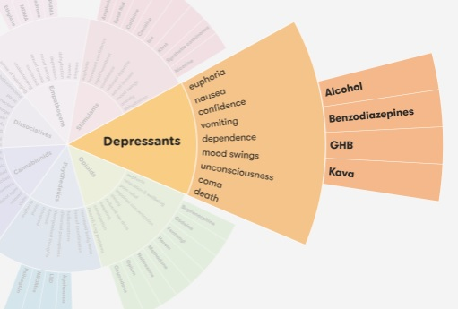
Depressants
Depressant substances reduce arousal and stimulation. They do not necessarily make a person feel depressed. They affect the central nervous system, slowing down the messages between the brain and the body
Notes:
Depressants can affect concentration and coordination. They slow down a person’s ability to respond to unexpected situations. In small doses they can cause a person to feel more relaxed and less inhibited.¹
In larger doses they can cause drowsiness, vomiting, unconsciousness and death

Slide 31
Usage depends on the specific type of depressant, for example, alcohol is drunk but benzodiazepines are usually swallowed and can also be injected. Generally, depressants can be swallowed, drunk as a beverage, injected, snorted or inhaled
Notes:
The onset and effects of depressants vary according to the type and specific chemical. Some depressants may work instantly, with effects only lasting for a short time (such as inhalants), while other depressants may take longer for the effects to start and may last longer.

Slide 32
Most Common Depressants & the Effect
Alcohol - Benzo’s (Xanax, Valium) – GHB - Kava
reduced inhibitions
enhanced mood
reduced anxiety
slowed reaction time
impaired judgement
slowed breathing
increased risk of accident or injury
Notes:
Higher doses can result in:
impaired judgement and coordination
vomiting
irregular or shallow breathing
blackouts and memory loss
unconsciousness
coma
death.

Slide 33
Using depressants with other drugs
Alcohol + benzodiazepines: decreased heart rate and breathing; overdose more likely
Benzodiazepines + opiates (such as heroin): breathing difficulties; an increased risk of overdose and death.
Notes:
The effects of taking depressants with other drugs – including over-the-counter or prescribed medications – can be unpredictable and dangerous

Slide 34
Dependence and Tolerance
People who use depressants regularly, can develop a dependence and tolerance to them. Tolerance means they need to take larger amounts of depressants to get the same effect.
Notes:
Dependence on depressants can be psychological, physical, or both. People who are psychologically dependent may feel an urge to use them when in specific surroundings or socialising with friends. With physical dependence, a person’s body adapts to the depressants and gets used to functioning with them.
People who depend on depressants may find that using the drug becomes more important than other activities in their life. Cravings can make it difficult to stop using depressants

Slide 35
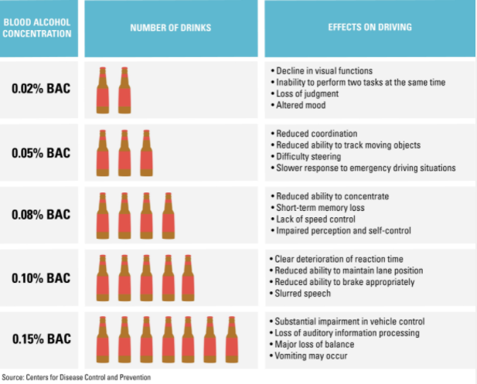
Driving and Depressants
Notes:
A 160-pound man that consumes two alcoholic beverages will experience some loss of judgment, decreased ability to rapidly track a moving target and reduced multitasking ability, according to the Centers for Disease Control and Prevention.
Women, who generally weigh less than men, would see a higher BAC per drink.
Three alcoholic drinks will bring a person’s blood alcohol level to approximately 0.05%, which can impair the ability to rapidly focus vision, lower alertness and decrease coordination — to the point that steering becomes difficult and response to driving emergencies becomes blunted.
After approximately four alcoholic drinks, one’s balance, vision and reaction time are often affected. It becomes harder to detect roadway dangers. Reasoning and information processing are often measurably impaired. This corresponds most closely to a BAC of 0.08%.
A blood alcohol concentration of 0.10% is generally associated with a clear loss of reaction time and control. There will be a reduced ability to maintain proper lane position or to brake appropriately.

Slide 36
One alcohol-related death occurs every 52 minutes
43.6 percent of fatally injured drivers in 2016 tested positive for drugs and over half of those drivers were positive for two or more drugs.
Alcohol, Drugs, Driving & You

